Slide 1
Development of a Traffic Light System using TinkerCAD

Slide 2
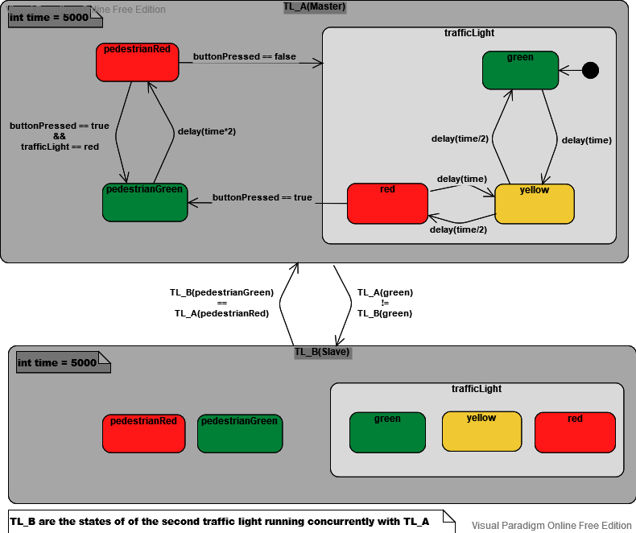
State Machine Diagram

Slide 3
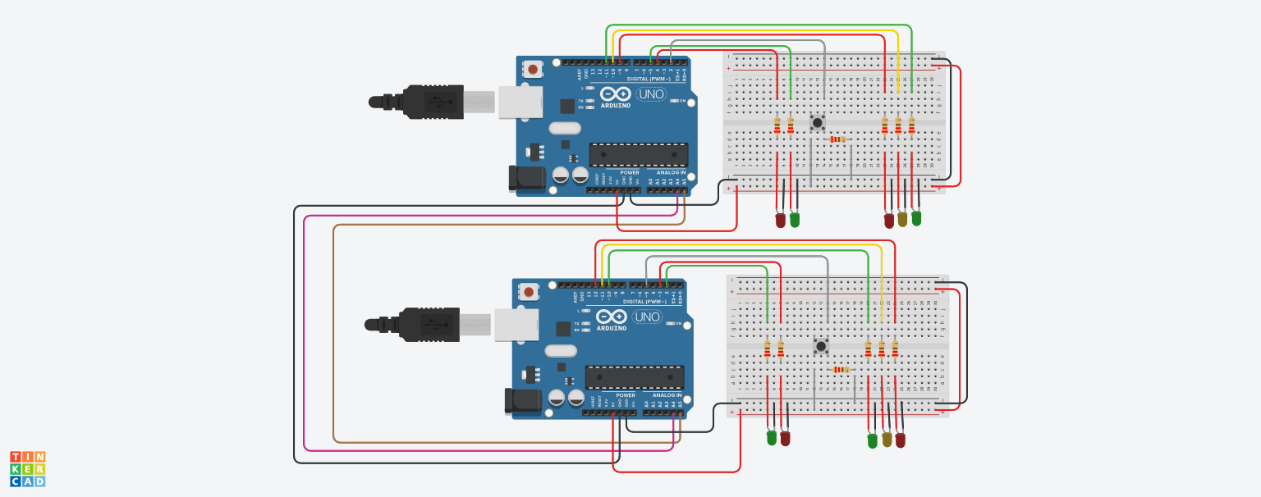
TinkerCAD circuit Explanation

Slide 4
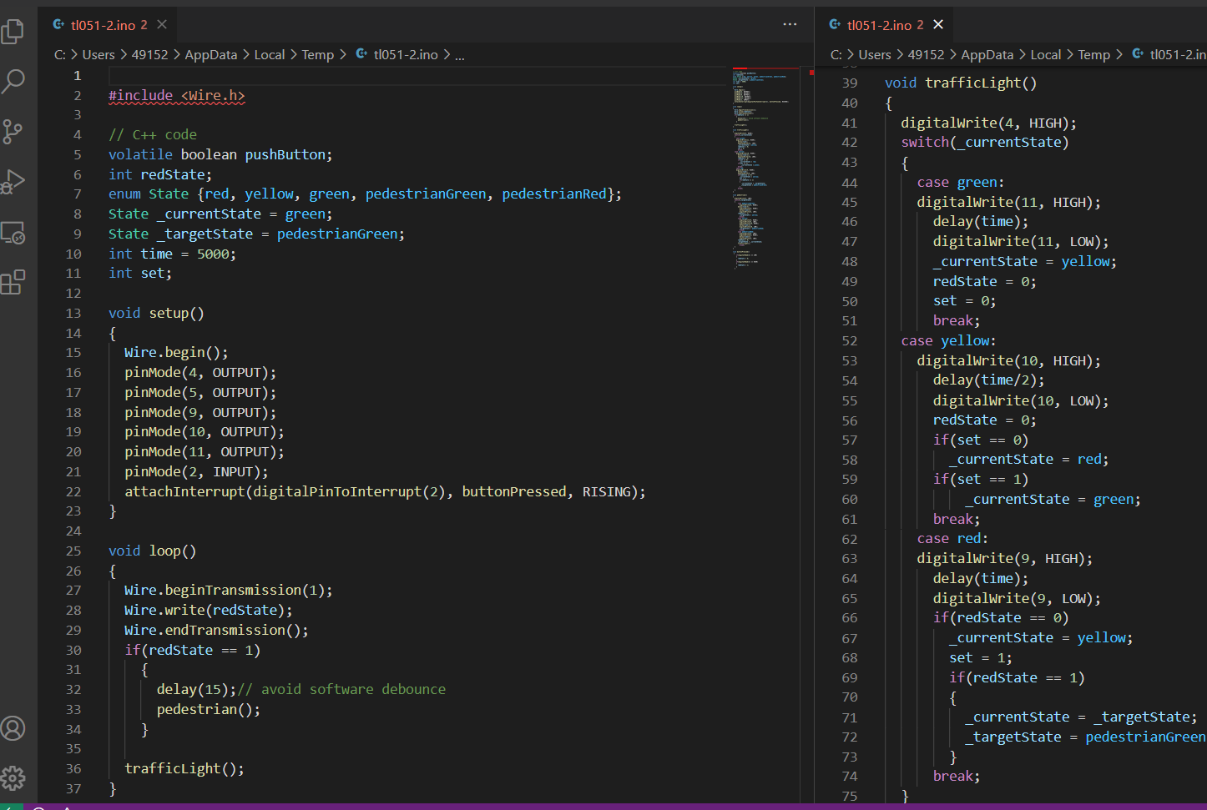
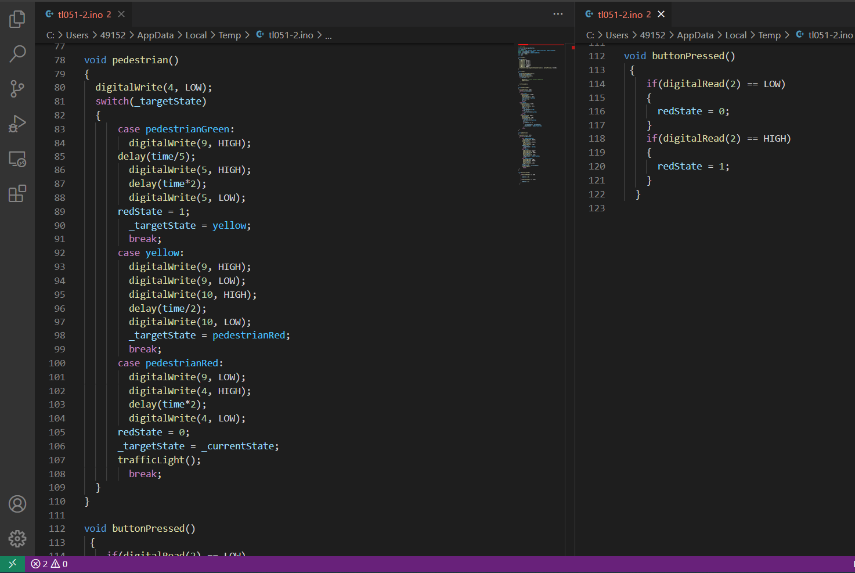
Code - master

Slide 5
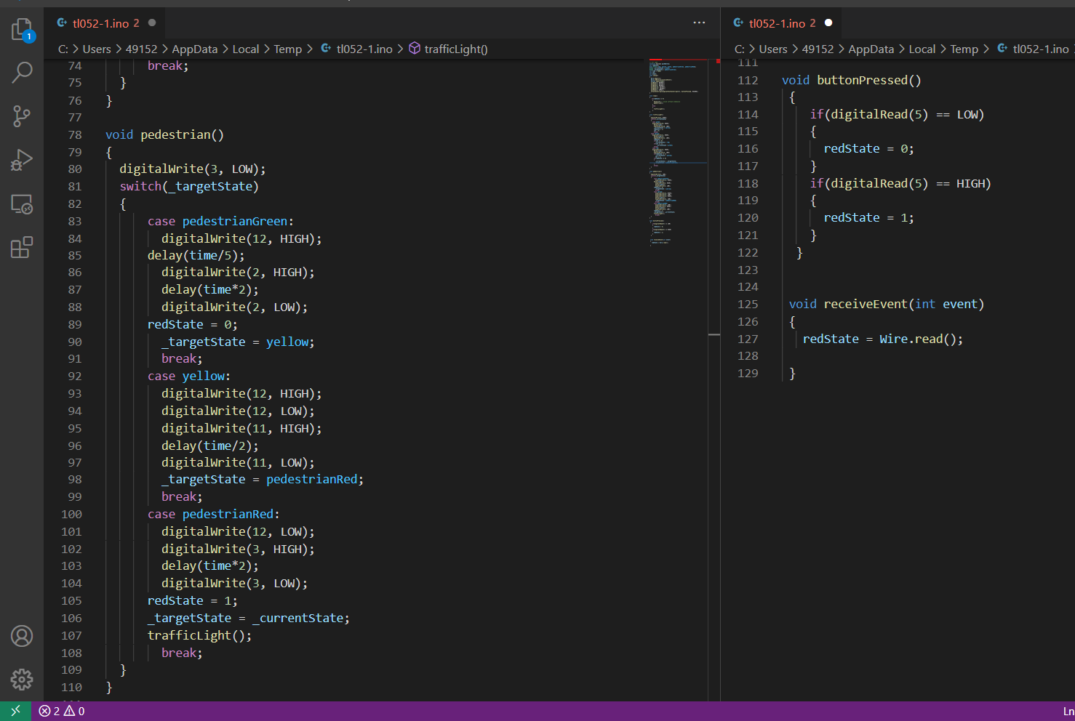
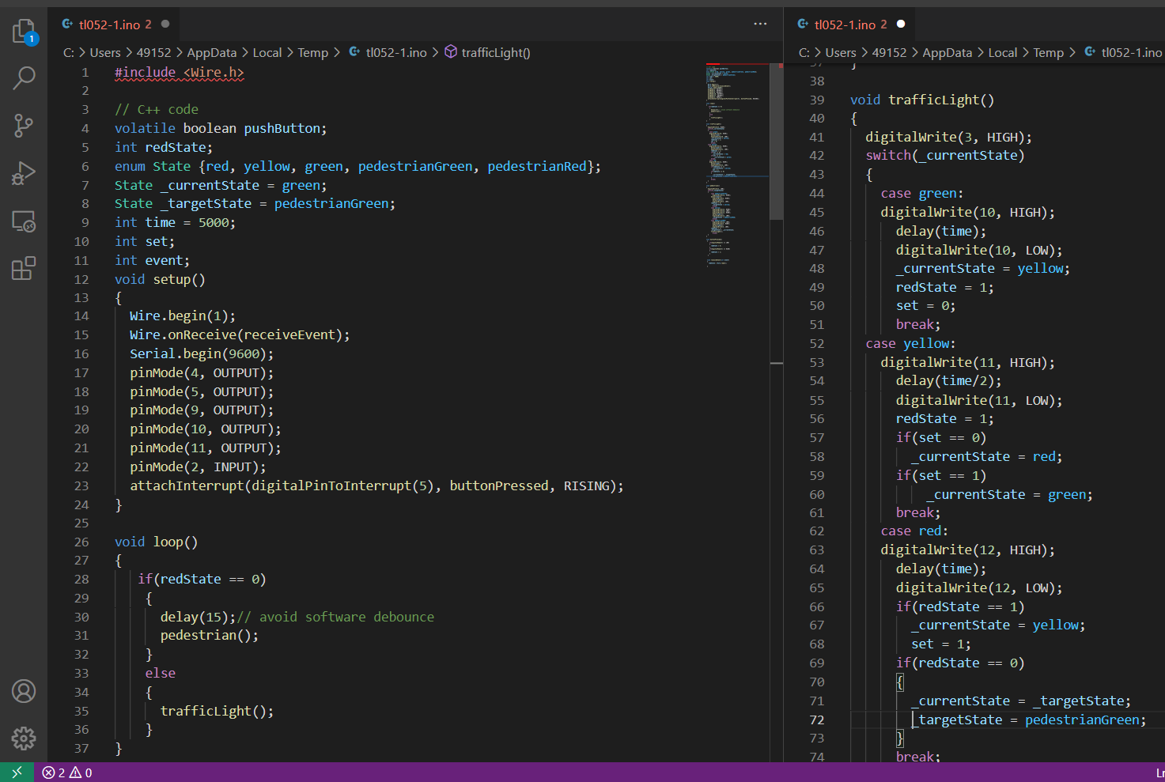
Code - slave

Slide 6
THANK YOU FOR LISTENING

